Slide 1
Basic Database Concepts

Slide 2
Objectives
Basic Concepts & Architecture
History
DBMS Benefits
DBMS Abstraction
Database Schema and State
Dr. Ejaz Ahmed

Slide 3
Non-Relational Systems
Database systems can be conveniently categorized according to the data structures and operators they present to the user
The oldest system fall into three broad categories:
  Flat-File Systems
  Hierarchical Systems
  Network Systems
We will not discuss these categories in great detail as, although some are still used, they are obsolete
We will focus on relational databases
Dr. Ejaz Ahmed

Slide 4
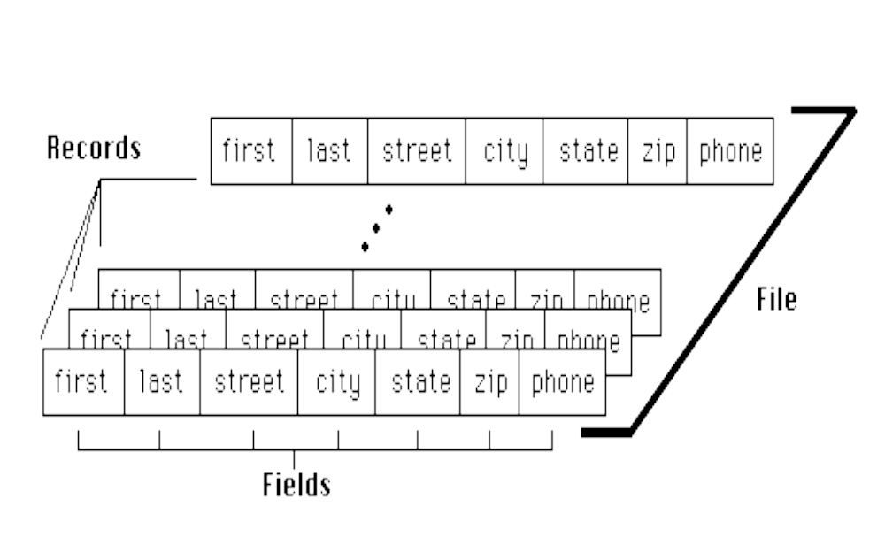
Files, Records, and Fields
Dr. Ejaz Ahmed

Slide 5
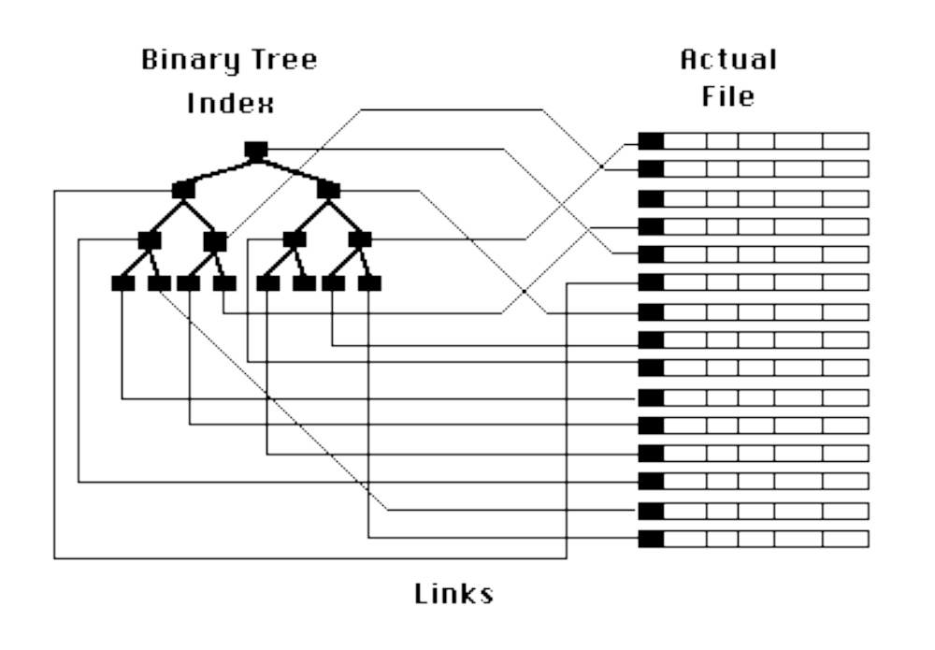
Indexed Files
Dr. Ejaz Ahmed

Slide 6
History of Database Systems
First-generation
  Hierarchical and Network
Second generation
  Relational
Third generation
  Object Relational
  Object-Oriented
Dr. Ejaz Ahmed

Slide 7
Terms and Concepts
Data Independence
  Physical representation and location of data and the use of that data are separated
    The application doesn’t need to know how or where the database has stored the data, but just how to ask for it
    Moving a database from one DBMS to another should not have a material effect on application program
    Recording, adding fields, etc. in the database should not affect applications
Dr. Ejaz Ahmed

Slide 8
Objectives of Three-Level Architecture
All users should be able to access same data
The user’s view is immune to change made in other views
User should not need to know physical database storage details
Dr. Ejaz Ahmed

Slide 9
Objectives of Three-Level Architecture …
DBA should be able to change database storage structures without affecting the user’s views
Internal structure of database should be unaffected by changes to physical aspects of storage
DBA should be able to change conceptual structure of database without affecting all users
Dr. Ejaz Ahmed
Notes:
Flow chart is a conceptual for programming. Using compiler and putting code in it means logical. Then some product is produced in the form of execution of program.
In logical, who will use program and what can get, some can get different from others means handled by using VIEWS in DBMS.

Slide 10
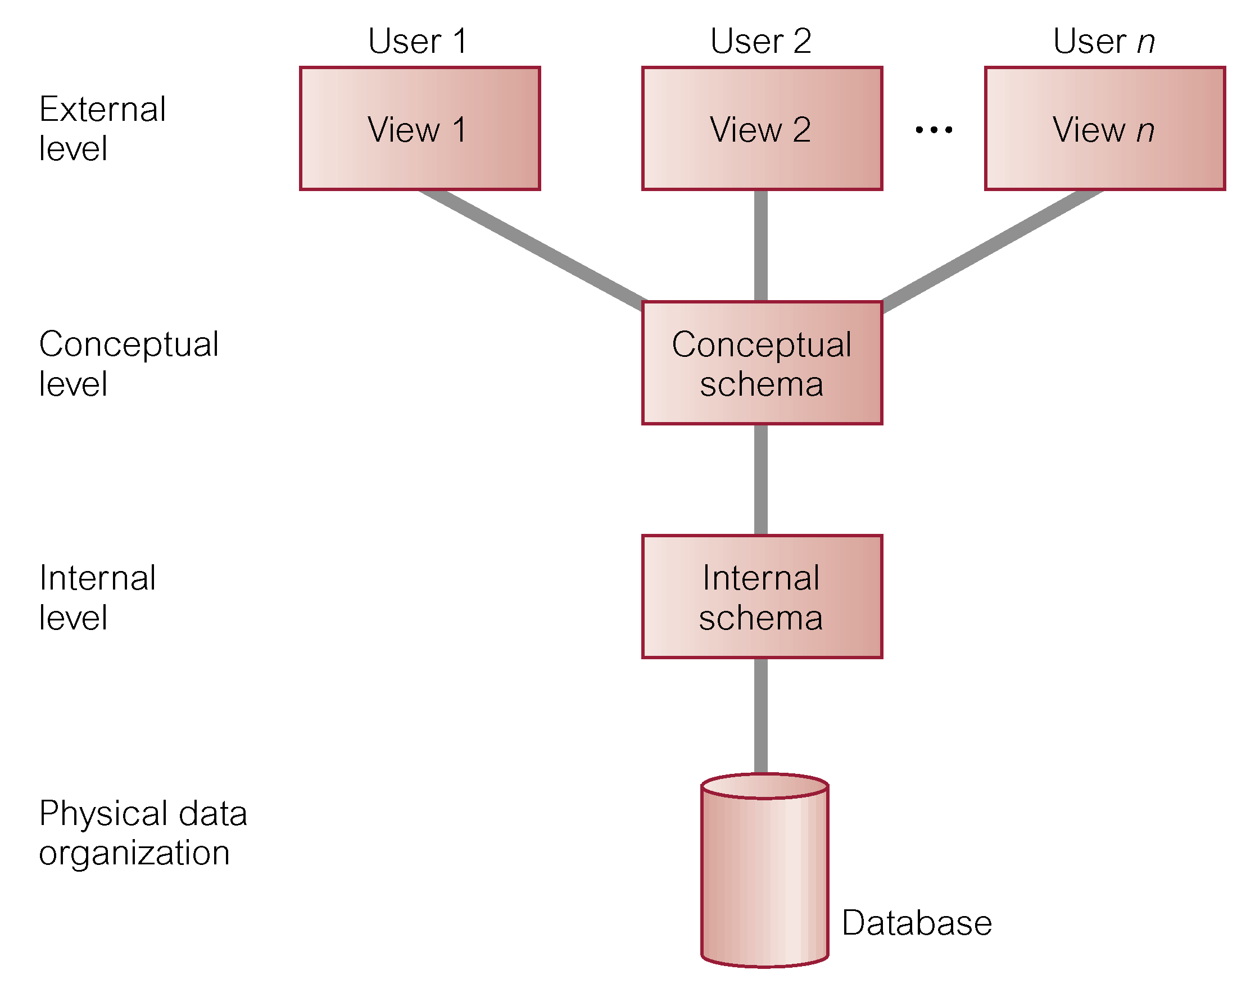
ANSI-SPARC Three-Level Architecture
Dr. Ejaz Ahmed
Notes:
Internal schema (is a part of Physical Level)) means DBMS managed by DBA (How to access data from physical level, providing temp buffer, OS-ODBC Connection, record structure of data-next slide, DBMS utilities/ components, how the data is stored), give rights and access to produce schema for conceptual schema. It hides many low level storage details. E.g., which schema tables are stored in which database files at physical OS level. Give virtual storage to users with respect to file(s) size at physical level
Conceptual level can be managed in logical way by using schema in DBMS is main schema where Model/design of database is implemented. User of conceptual schema will give rights to other users (using synonyms, VIEWS, procedures, functions etc., structure rather than data duplications copies). Logical means data access comes from single repository source in visual environment, however data is originated from multiple files and locations (Physical data).
Data storage at physical level means how data is stored at OS level.
Data is stored in the form of files with locations such as disc drives and files/ folders. Files have different types such as image files, sound files, text files and rich text files, DBMS owns files etc.
VIEW means storing SQL, contains no data but extract data from community data (conceptual level) when needed. VIEWS are different for different users.
At Conceptual level community data or tables are managed, such tables are shared with VIEWS for external level’s users.
For example, a community table of results of all students (all campuses) is designed at conceptual level but each student can see his/ own result through VIEW but not results of all students
Questions: Where exactly SQL programming and client applications programming are managed?

Slide 11
ANSI-SPARC Three-Level Architecture
External Level
  User’s view of the database
  Describes that part of database that is relevant to a particular user
Conceptual Level
  Community view of the database
  Describes what data is stored in database and relationships among the data
Dr. Ejaz Ahmed

Slide 12
ANSI-SPARC Three-Level Architecture
Internal Level
  Physical representation of the database on the computer
  Describes how the data is stored in the database
Dr. Ejaz Ahmed

Slide 13
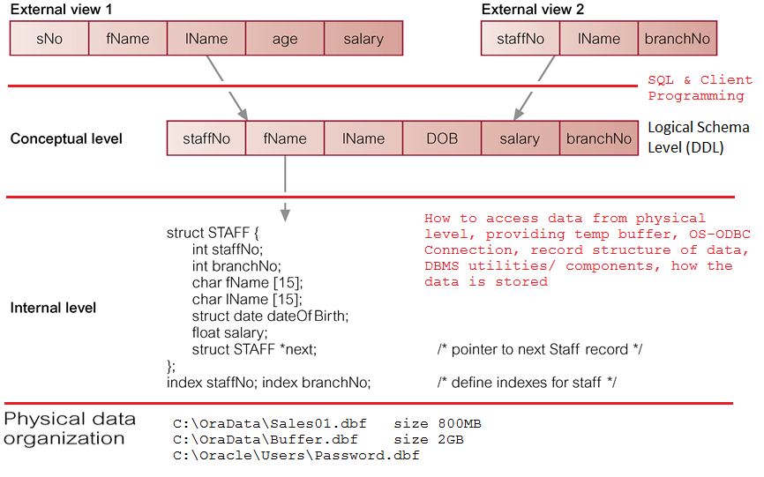
Three Levels of ANSI-SPARC Architecture - Example
Dr. Ejaz Ahmed
Notes:
Flow chart is a conceptual for programming. Using compiler and putting code in it means logical. Then some product is produced in the form of execution of program.
In logical, who will use program and what can get, some can get different from others means handled by using VIEWS in DBMS.
Physical & Logical levels are independent. For example, renaming a physical database file does not rename the tables whose data is stored in this file
Representing database as seen by the DBMS
Mapping of conceptual model to the DBMS
Internal schema depicts a specific representation of an internal model
Depends on specific database software
Change in DBMS software requires internal model to be changed
Logical independence: change internal model without affecting conceptual model

Slide 14
Data Independence
Logical Data Independence
  Refers to immunity of external schemas to changes in conceptual schema
  Conceptual schema changes (e.g. addition/removal of entities)
  Should not required changes to external schema or rewrites of application programs
Dr. Ejaz Ahmed

Slide 15
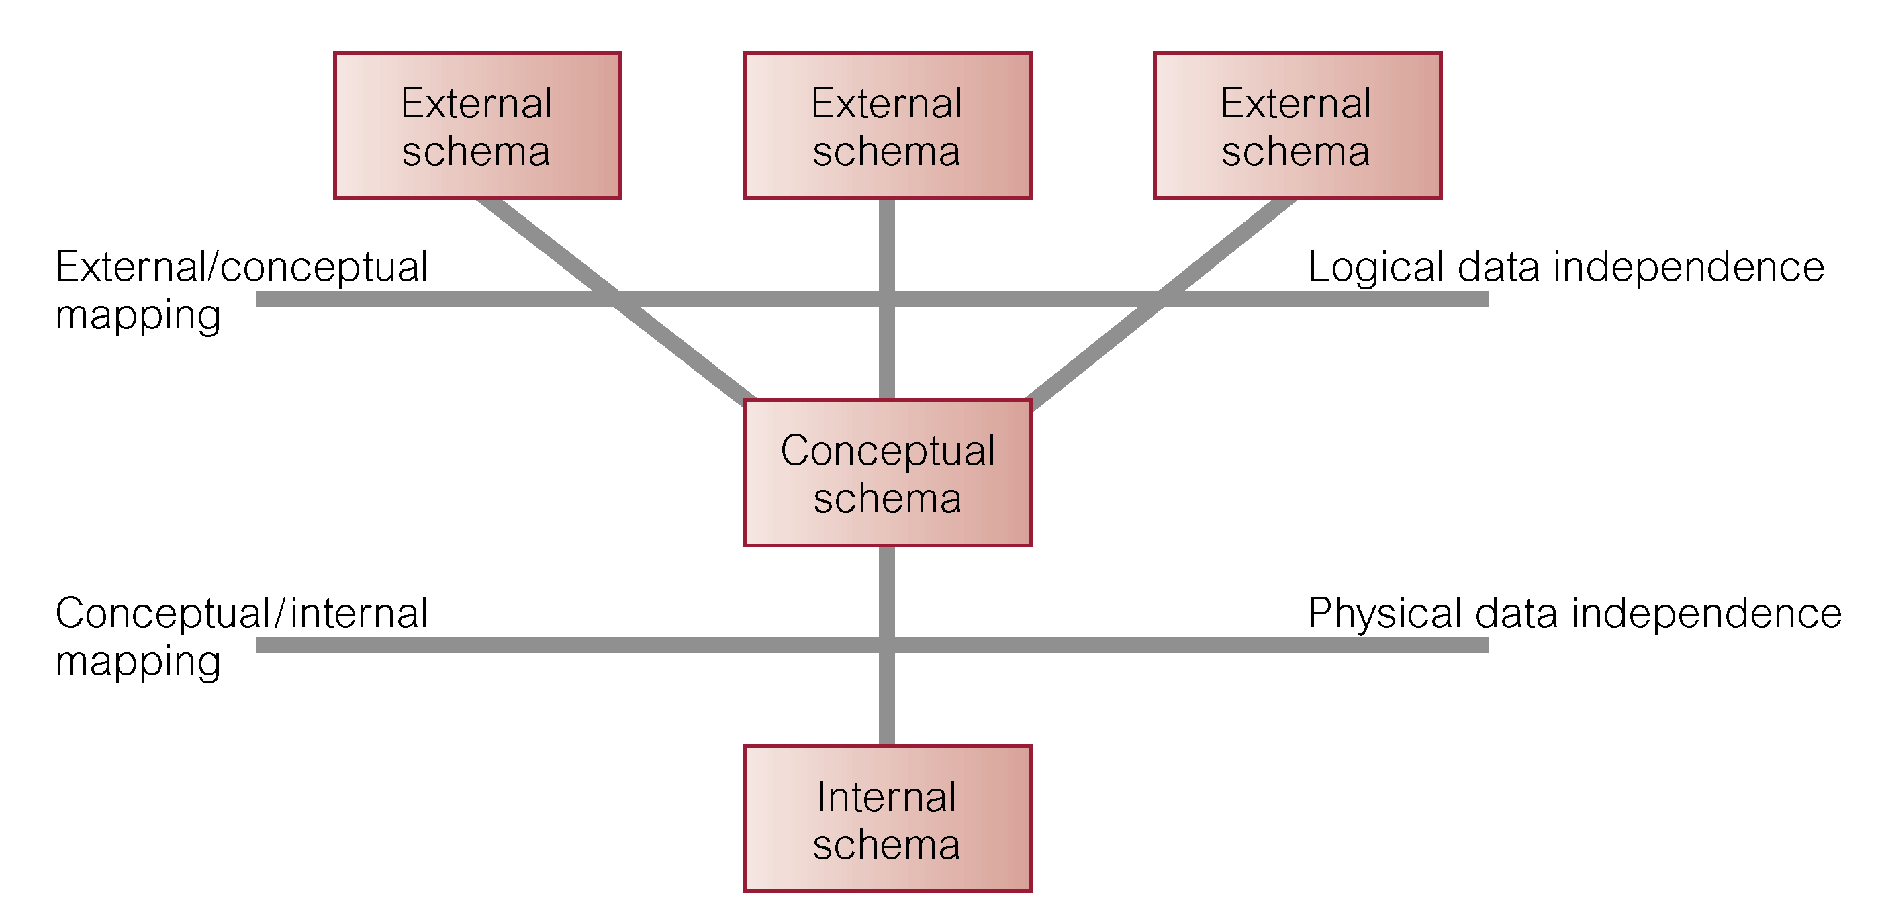
Data Independence and the ANSI-SPARC Three-Level Architecture
Dr. Ejaz Ahmed
Notes:
SQL and client programming is required to provide data from Conceptual level to external levels

Slide 16
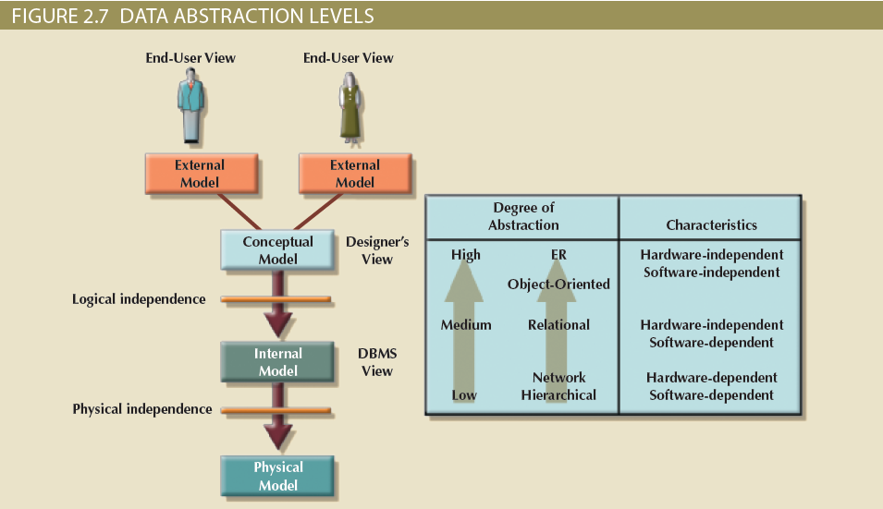
Degrees of Data Abstraction
Dr. Ejaz Ahmed

Slide 17
Schemas and Instances
Similar to types and variables in programming languages
Schema – the logical structure of the database
  E.g., the database consists of information about a set of customers and accounts and the relationship between them
  Analogues to type information of a variable in a program
  Physical schema: database design at the physical level
  Logical schema: database design at the logical level
  Sub-Schema: there may be several of these at the view level, each a different view of database
Instance – the actual content of the database at a particular point in time
  Analogous to the value of the variable
Hello
Dr. Ejaz Ahmed
Notes:
At Conceptual level community data or tables are managed, such tables are shared with VIEWS for external level’s users.

Slide 18
-- Database Schema
Is the description of a database
It is specified during the database design and is not expected to change frequently.
It is represented as a diagram called schema diagram.
  A schema diagram displays the structure of each record type but not the actual instance of a record.
Each object in a schema is called a schema construct.
Dr. Ejaz Ahmed
Notes:
DBMS schema objects includes Tables, Indexes, Constraints, Procedural Program (PL/SQL, Classes of Java, Function of C etc), Sequences, Views, Clusters, Triggers, Links, User Defined Types, Synonym
Just like a users profile in windows, user can store its files/ data in My Document. No other user can access this folder without permission, analogy to a schema

Slide 19
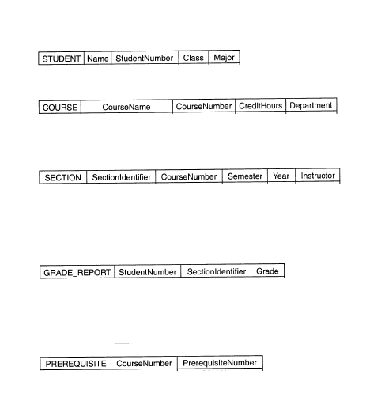
--- Example of a Database Schema
Dr. Ejaz Ahmed

Slide 20
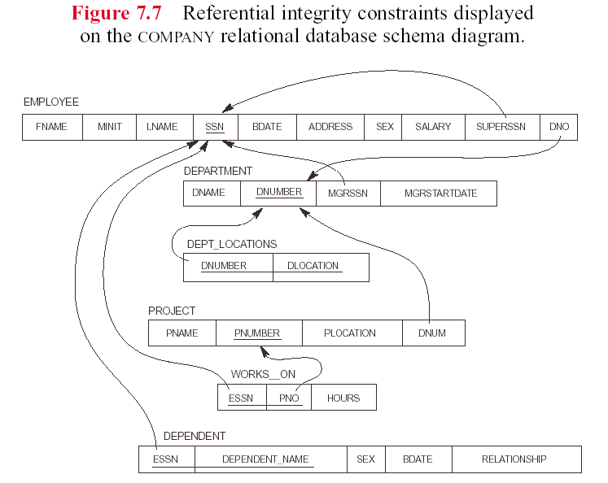
Dr. Ejaz Ahmed
Notes:
Arrows means FK constraints and Underlined means PK

Slide 21
DBMS Schema Objects
Tables
Indexes
Constraints
Sequences
Views
Clusters
Triggers
Links
9. User Defined
10. Types
11. Synonym
12. Dimensions
13. Procedural Program codes in PL/SQL, Java, C etc.
Dr. Ejaz Ahmed

Slide 22
-- Database State
A Database state or instance is the data in the database at a particular moment of time.
Every update operation changes the database from one state to another.
The Schema is sometimes is called the intension, and the database state an extension of the schema.
Dr. Ejaz Ahmed

Slide 23
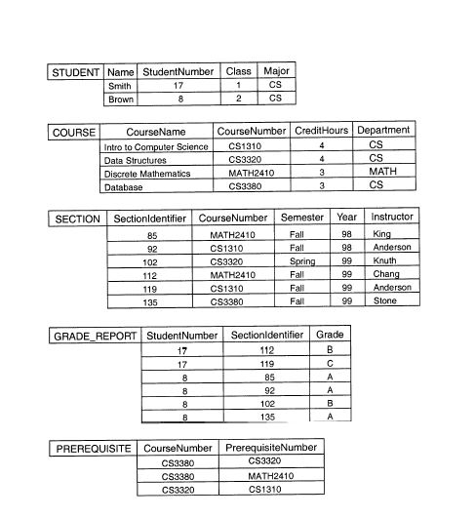
-- Example of a Database State
Dr. Ejaz Ahmed

Slide 24
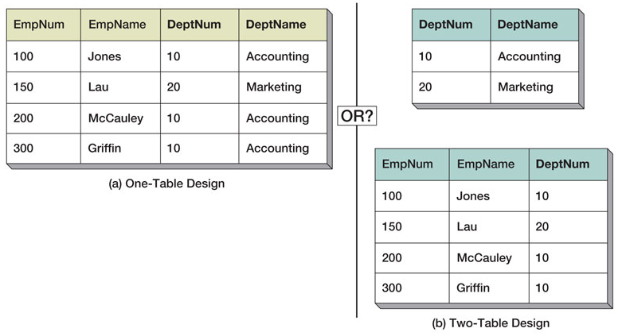
Data Redundancy & Design
Dr. Ejaz Ahmed
Notes:
Accounting is repeating – redundant data. Breaking table into multiple tables to remove redundancy – Normalization
In table-a, modifying and deleting deptname many times.

Slide 25
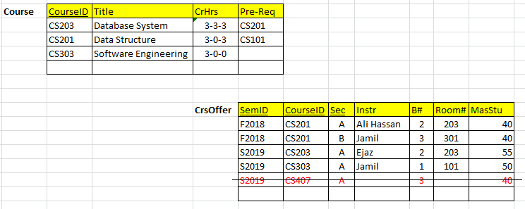
Datasets
Any dependency?
Which columns require references or dependencies?
Any data redundancy or duplication?
Dr. Ejaz Ahmed
Notes:
Almost all possible variety of records in a data. Such variety should be applicable for the user. Fewer numbers of records are sufficient for the purpose of initial software development/ programming. Later on records can be increased for formal Testing

Slide 26
END
Dr. Ejaz Ahmed

